Slide 1
UAV Wing Design For Efficiency At Low Reynolds Numbers
Presented by Devin Jensen
Embry-Riddle Aeronautical University

Slide 2
Wing Design
Overview
2D optimization
3D optimization
Control
Lessons Learned

Slide 3
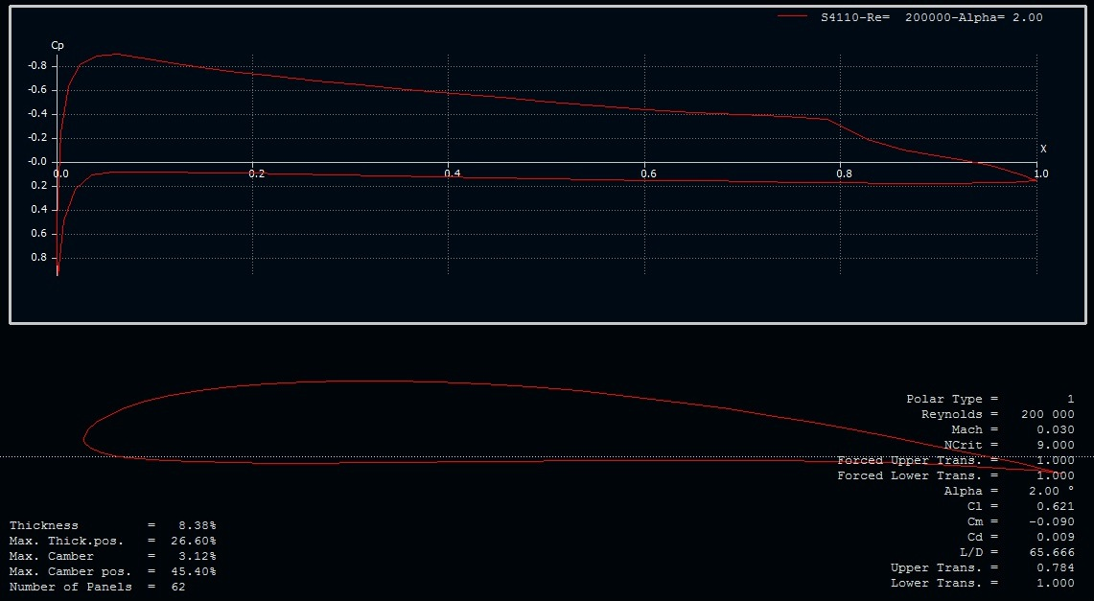
2D Optimization
Airfoil chosen from Selig and Eppler airfoils
Sellig 4110 chosen
High Cl/Cd
Acceptable pitching moment
Wing Design

Slide 4
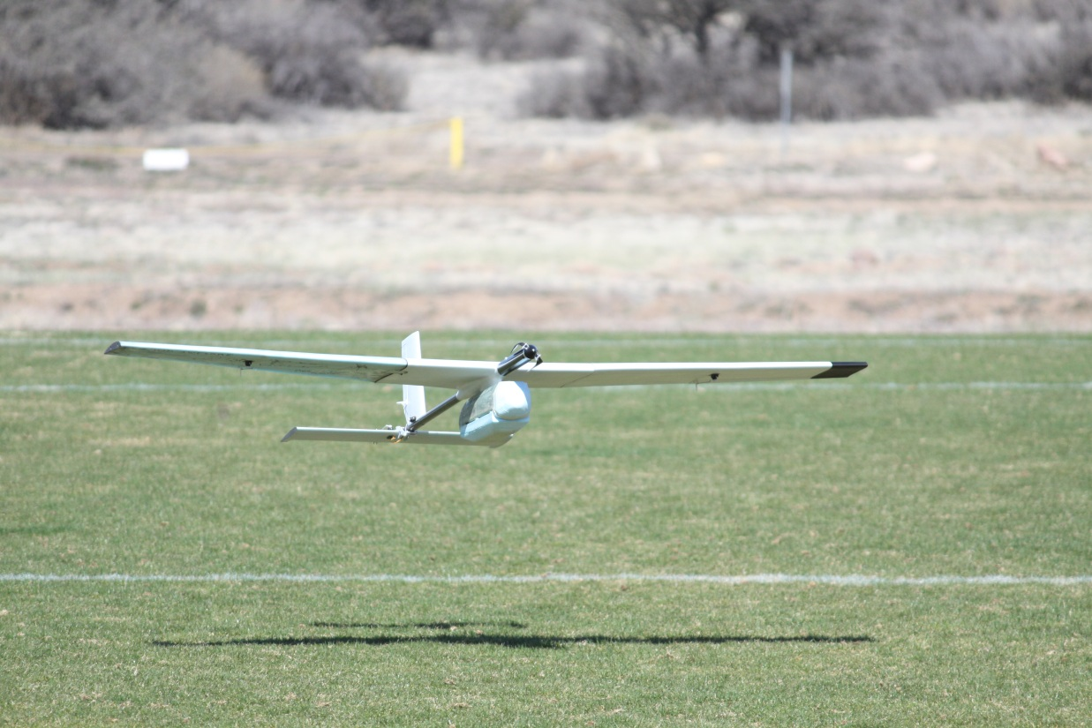
3D Optimization
Estimated weight of 8 lbs.
Wanted 10 lbs. of lift
Analyzed a series of wing geometries
Calculated lift and drag
Wing Design

Slide 5
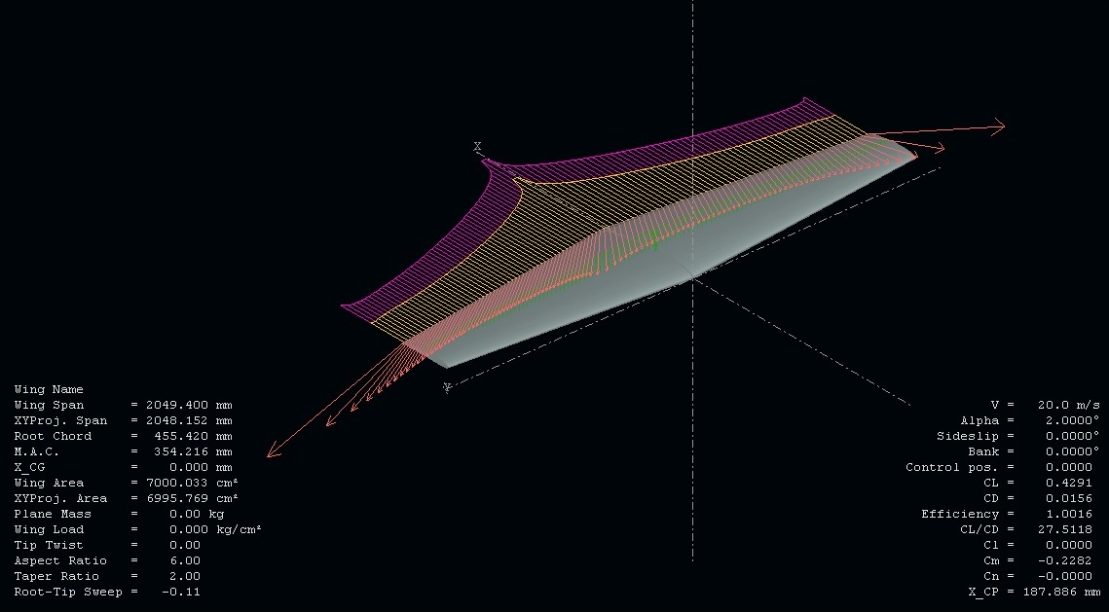
Wing Design
3D Optimization
Continued
Wing geometry description for chosen wing
Aspect Ratio = 6
Taper Ratio = 0.5
C/4 sweep = 0
Planform Area = 7.5 square feet

Slide 6
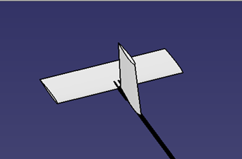
Control
20 percent of wing area for horizontal tail
10 percent of wing area for horizontal tail
Ailerons, rudder and elevator used for control
Wing Design

Slide 7
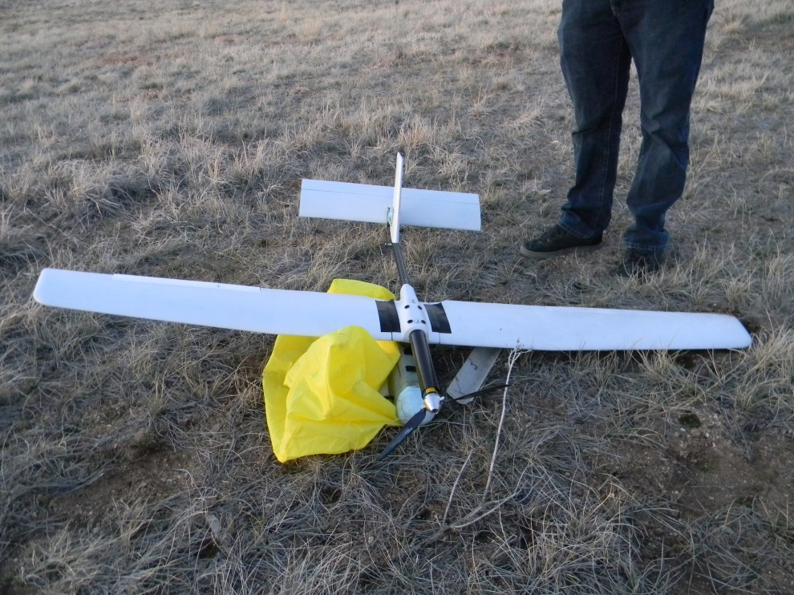
Lessons Learned
V-Tail
Flaps
Greater tail area
More dihedral
Pod attachment
Addition of incidence angle
Wing Design

Slide 8
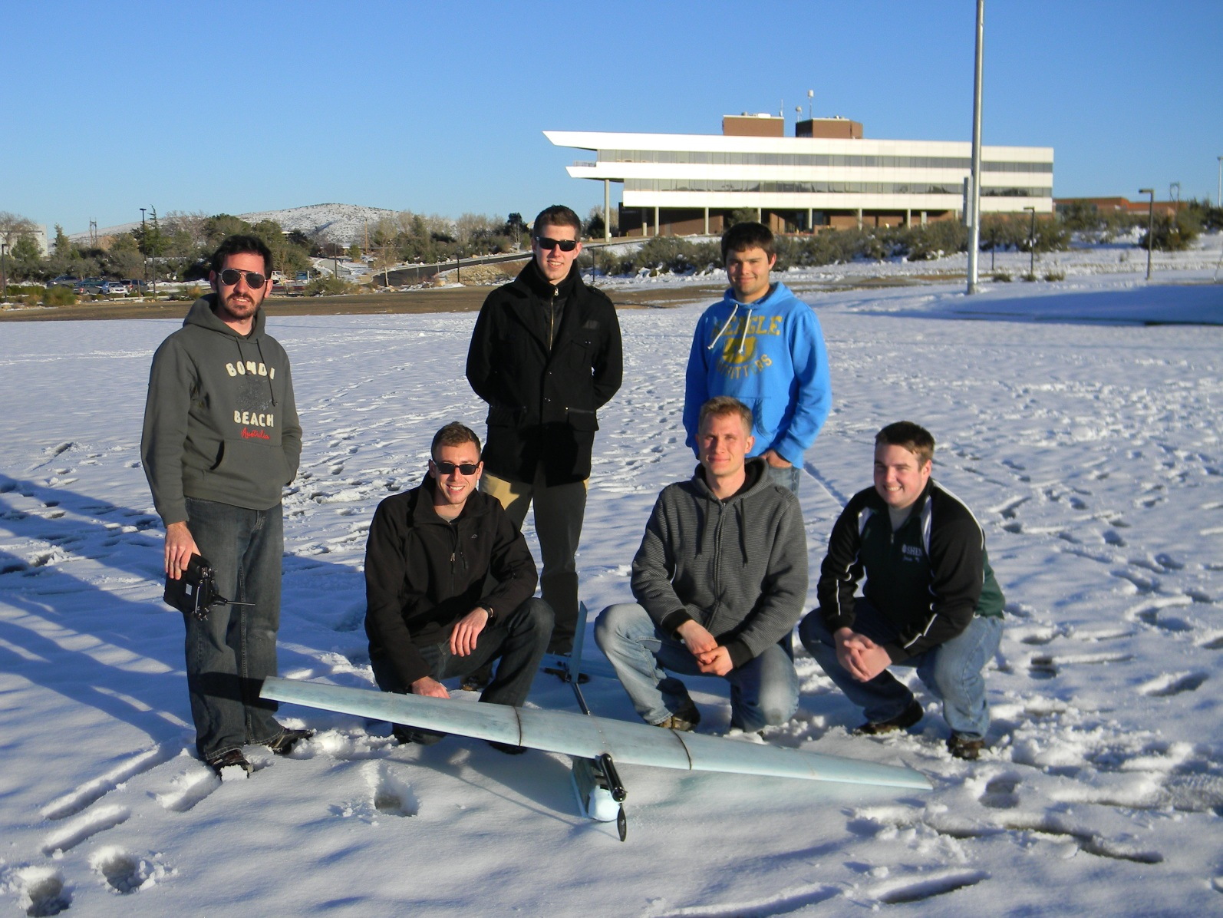
Questions?

